Slide 1
AABG Guide to Amazon Web Services TRAINING
19 AUGUST 2021

Slide 2
play your part in growing a $2b+ business Why AWS Certification?
1
Clients are asking for it
2
An objective standard of job readiness on AWS
3
Certifications for sales & delivery roles
4
Manageable time options and support
AABG Only Partnership of it’s Kind
Visit AWS Training page for details

Slide 3
Amazon Web Services Training Overview
This guide describes the following:
Skilling Model and Recommended Learning Paths for certification
How to access A Cloud Guru courses
How to access Accreditation courses
How to access Foundational AWS courses (pre-requisites to Certification)
Key Contacts

Slide 4
Skilling model and Recommended Learning paths

Slide 5
AWS SKILLING MODEL
Architects
Developers
Systems Operations
Executive/Sales/Operations
Certification-Professional Level | Specialty Certifications
Immersion Sessions/Workshops
Thought Leadership
Expert
Community of Practice
Delivery
Experience
Exam Preparation & Review
Certification-Associate Level
Certification-Cloud Practitioner
Proficiency Level
Job Ready
Exam Preparation & Review
Foundational Training
Shadowing /
Coaching
T1
Conversant
Accreditation
Self Study &
Communications
Introductory Materials: Videos

Slide 6
Get AWS Certified: cloud practitioners
1
Review basics
2
complete foundational training
3
Prepare for exam
4
Take the exam
AABG Only Partnership of it’s Kind
Complete:
Accreditation: Business
4.5h Self study
$0 Cost
Via AWS Partner Portal
(see slide 11 for access
Instructions)
Complete Cloud
Practitioner Essentials
6h Self study
$0 Cost
Via AWS Training Portal
Review
AWS White Papers/FAQs
~2h
$0 Cost
Via AWS Training Portal
See exam Voucher and
Scheduling guidance on
slide 8 of the AABG Guide
to AWS Certification
Visit AWS Training page for details

Slide 7
Get AWS Certified: Associate level Solution Architect, Developer, Sysops administration
1
get accredited on the partner portal
2
complete role-based foundational training
3
Prepare for exam
4
Take practice and final exam
AABG Only Partnership of it’s Kind
Complete one of:
Accreditation: Technical
3h Self study
$0 Cost
You must log in via
AWS Partner Portal to
access link
(see slide 11 for access
Instructions)
Complete one of:
Architecting on AWS
Developing on AWS
SysOps Admin on AWS
Via A Cloud Guru
20h
Tuition applies
or vILT where available
Prepare using:
AWS White Papers/FAQs
Hands on via optional
free tier account
15 hours
$0
See exam Voucher and
Scheduling guidance on
slide 8 of the AABG Guide
to AWS Certification
Visit AWS Training page for details

Slide 8
Get AWS Certified: professional and specialty certifications
1
Obtain your associate level certification
2
Get hands on
3
Prepare for exam
4
Take practice and final exam
AABG Only Partnership of it’s Kind
Complete:
Associate level
Certification
Prepare using:
AWS Free Tier Account
A Cloud Guru
~30h
Tuition applies
Prepare using:
AWS White Papers/FAQs
Hands on via optional
free tier account
~30h
$0
See exam Voucher and
Scheduling guidance on
slide 8 of the AABG Guide
to AWS Certification
Visit AWS Training page for details

Slide 9
How to access A cloud guru courses

Slide 10
Accessing a cloud guru courses for certification preparation
Accenture has a licensing agreement with A Cloud Guru.
For AWS Associate, Professional and Specialty certification, A Cloud Guru is the platform of choice for completing pre-requisite courses, for getting hands on access to labs and console playground, practice exams, and more
Access if available as follows
Course # A15309 Course Name: A Cloud Guru (FY21) Access – for AWS, Azure, & GCP Course link: https://mylearning.accenture.com/mylearningui/learner/coursedetail/1779659
Tuition: $163
All questions about status of your registration or access issues should be directed to learning.vendor.mgmt@accenture.com
Once you register, and your registration is approved, you will have access to the platform through 31 December 2021.

Slide 11
How to access AWS Accreditation & Cloud Practitioner courses

Slide 12
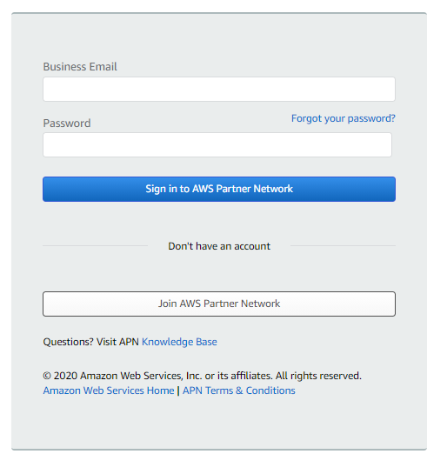
Amazon Web Services Training Step 1: Create Partner Portal Account
Go to https://partnercentral.awspartner.com/APNLogin
Click the ‘Join AWS Partner Network’ button
Complete the form.
Click Submit
NOTE: You must use your Accenture email address to create a partner portal account

Slide 13
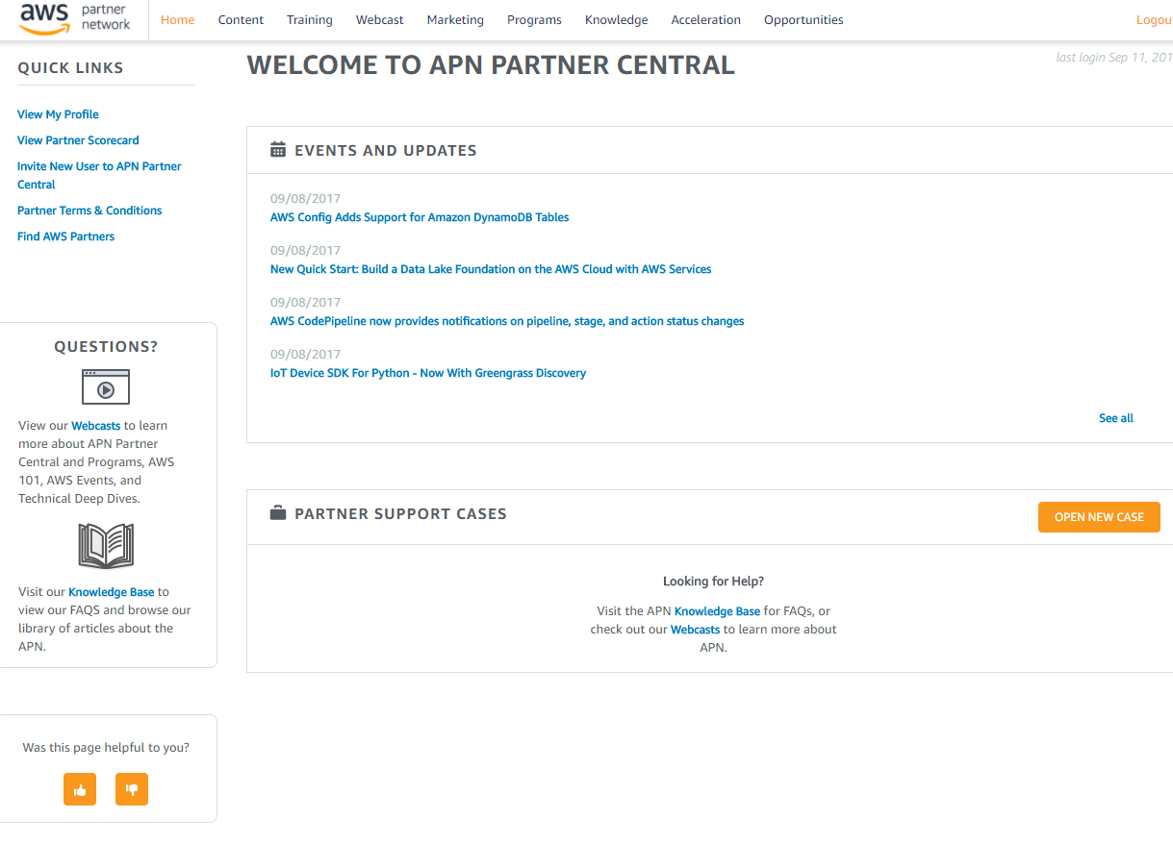
Amazon Web Services Training Step 2: Log in and Access the Amazon Partner Training Site
Once your partner portal account is set up, log in using your new credentials, then...
To register for the AWS Partner: Accreditation (Business) course, paste the following link in your browser’s address bar (click sign in if prompted: ) https://www.aws.training/Details/Curriculum?id=30254
To register for the AWS Partner: Accreditation (Technical) course, paste the following link in your browser’s address bar (click sign in if prompted: ) https://www.aws.training/Details/Curriculum?id=45423
To register for the Cloud Practitioner Essentials course, paste the following link in your browser’s address bar: (click sign in if prompted: ) https://www.aws.training/Details/eLearning?id=60697

Slide 14
How to register for foundational courses

Slide 15
How to register for foundational courses
To register for Foundational training offered as self-directed courses via A Cloud Guru:
Register in myLearning at this link
To register for the Foundational Cloud Practitioner Essentials course, visit the AWS Learning Portal at this link

Slide 16
CONTACTS

Slide 17
Amazon Web Services Training Questions or Concerns
If you have any questions or concerns you may contact any of the following:
For A Cloud Guru access: Learning.Vendor.Mgmt
For general AWS skilling questions: Jeff Hammond, Accenture-AWS Business Group Partner Programs Lead
For specific questions on AWS training and certification support: l.torres.sanmarco and urvashi.j.srivastava of the Cloud First Learning Team

